Slide 1

AI-Driven Recruitment & HR: Recruitment Approval Workflow
SOA Project Review-1
Date& Time
 | Under the Guidance of Dr.Neelima gogineni Assistent Professor, Department of Computer Science and Engineering, KLH CSE Bowrampet Campus
Team Members Name : D.Vinay Varma Roll Number : 2420030272 Name : R.Harshit Roll Number : 2420030271 Name : Sai Teja Roll Number : 2420030764

Slide 2
Outline of Project Work
Focus
Introduction
Literature Survey
Challenges
Research Objectives
Conclusion & Future Work
References
Publications Details

Slide 3
Problem Statement
Organizations often manage recruitment requests through manual or loosely integrated processes involving emails, spreadsheets, and multiple departments.
This can lead to:
Delayed approval of recruitment requests
Lack of centralized request tracking
Difficulty monitoring approval status
Unauthorized access to recruitment information
Poor communication between recruiters and HR
Limited scalability of monolithic systems
Difficulty maintaining an auditable approval history

Slide 4
Objectives
Develop a digital recruitment request submission system.
Implement role-based access for Recruiters, HR personnel, and Administrators.
Automate recruitment approval and rejection workflows.
Provide real-time request status tracking.
Implement secure authentication using JWT.
Use independent microservices for different business functionalities.
Implement service discovery using Eureka.
Implement centralized API routing using Spring Cloud Gateway.
Maintain separate databases for individual services.
Implement asynchronous notifications using Kafka.
Provide REST APIs for service communication.
Test APIs and services using Postman and automated tests.

Slide 5
Literature Survey
Authors | Title of the Paper | Methodology | Inferences | Limitation/Future work
Abhishek, Hemank Lamba, Rajat Vikram Singh & Sunpreet Arora — IIIT Delhi | WorkFlow Management System for a Recruitment Agency | Developed a workflow system for a recruitment agency that manages client requirements, resume matching, candidate selection, interviews, status updates and hiring completion. | Demonstrates how recruitment activities can be organized into a structured digital workflow with centralized tracking. | Focuses mainly on recruitment-agency and candidate-processing workflows rather than an independent microservice-based internal approval workflow.
Di Francesco et al. | Deployment and Communication Patterns in Microservice Architectures: A Systematic Literature Review | Systematic analysis of microservice deployment and communication patterns | Identifies different communication and deployment approaches used in microservice systems | Selecting appropriate patterns remains dependent on system requirements
Sai Ram Deekonda, S. Mahesh & Mahesh Vennu — Hyderabad/Bengaluru | Web-Based Placement Workflow Management System Using MERN Stack | Implemented a MERN-based placement system with JWT authentication, RBAC, company management, application tracking, eligibility filtering and audit logging. | Demonstrates the usefulness of role-based workflows and centralized tracking for recruitment-related processes. | Uses a three-tier MERN architecture rather than the Spring Boot microservices/SOA architecture proposed in our project. Advanced analytics and some additional features were left for future enhancement.

Slide 6
Problem Gap Identification
Existing systems mainly focus on candidate management, placement, and recruitment-agency workflows, rather than internal recruitment approval.
Existing recruitment systems use MERN/three-tier architectures instead of Spring Boot microservices/SOA.
There is limited separation of User, Recruitment, Approval, and Notification services.
Event-driven approval notifications using technologies such as Kafka are not emphasized.
Therefore, there is a need for a scalable microservices-based Recruitment Approval Workflow with JWT, RBAC, API Gateway, service discovery, and event-driven notifications.

Slide 7
Innovation, Creativity, and Novelty
Microservices-based design: Separates User, Recruitment, Approval, and Notification services for independent management.
Automated approval workflow: Digitizes the recruitment request → HR review → approval/rejection process.
Event-driven notifications: Uses Kafka to trigger notifications when recruitment requests are approved or rejected.
Secure access: Implements JWT authentication and role-based authorization for Recruiters, HR, and Admins.
Scalable SOA architecture: Uses Eureka, Spring Cloud Gateway, and database-per-service to improve scalability and service independence.

Slide 8
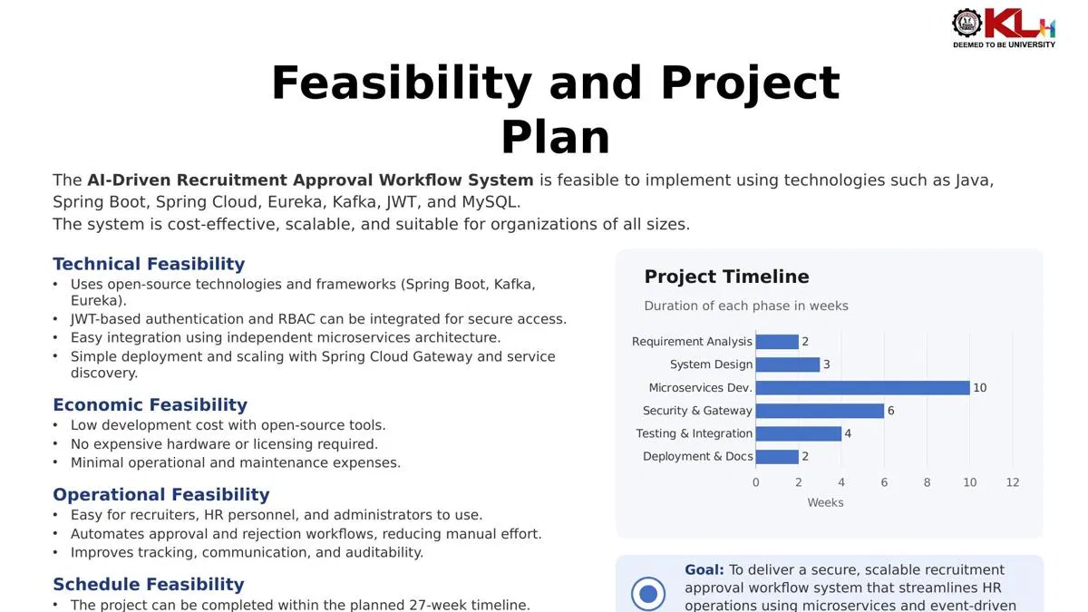
Feasibility and Project Plan
TIMELINE CHART FOR EACH PHASE OF YOUR PROJECT SHOULD BE THERE AFTER EXPLANATION

